Slide 1
Watson Machine Learning & Deep Learning in Watson Studio HOPi June 2018 **DRAFT** In Development by Mayur Khatri and Adam Massachi
IBM Confidential

Slide 2
Quick Intro to Deep Learning
Notes:
Traditional machine learning focuses on selecting the right algorithm then tweaking the few available parameters. Deep learning significantly increases the complexity of model building by requiring data scientists to first design then tweak the dozens of interrelated parameters in neural networks structures. But AI is where all the complexity converges. We speak about AI as though it’s a single model or neural network but it’s not. AI is about multiple algorithms, neural networks, data and support systems working together as a system. So the challenge of AI is not about training a single model but about architecting numerous data-driven services which that the underlying complexity and hidden and emerges as a seemingly cognitive system.

Slide 3
Use Cases for Deep Learning
Cyber Defense
Fraud Detection
Drug Discovery
Aeronautics
IoT
Medical
Decision-Making
Smart Cities
Earth Monitoring
Weather Forecasting
Disease Diagnostics
Climate Change
Robotics
Advanced Physics Research
Media Analytics
Supply Chain Management

Slide 4
How does
machine learning work?
data
data
1
A machine learning model is
trained to to recognize
patterns in historical data
data
training data
data
data
data
model
2
The model is then shown
new data and asked to predict or classify it.
?
?
?
Machine learning requires
TONS OF DATA
3
prediction
or
classification
If patterns in the new data match the training data then the model makes accurate predictions

Slide 5
Deep Learning = Training Artificial Neural Networks
Based on biological neurons. Artificial neurons learn by recognizing patterns in data.
A human brain has:
200 billion neurons
32 trillion connections between them
Artificial neural networks have far fewer

Slide 6
Machine Learning is algorithm selection
Deep learning is neural network design
AI is systems architecture
Notes:
Traditional machine learning focuses on selecting the right algorithm then tweaking the few available parameters. Deep learning significantly increases the complexity of model building by requiring data scientists to first design then tweak the dozens of interrelated parameters in neural networks structures. But AI is where all the complexity converges. We speak about AI as though it’s a single model or neural network but it’s not. AI is about multiple algorithms, neural networks, data and support systems working together as a system. So the challenge of AI is not about training a single model but about architecting numerous data-driven services which that the underlying complexity and hidden and emerges as a seemingly cognitive system.

Slide 7
Most AI solutions require neural networks that don’t yet exist
pre-trained
neural network
transfer learning
custom
neural networks
required
+
Application Developer
SME
domain
data
data scientist

Slide 8
How do the paths to AI-powered apps relate?
SME
data scientist
domain
data
Pre-Trained
Model
Custom Model
transfer learning
model
Application Developer
Deploy to application

Slide 9
Deep Learning in Watson Studio
Notes:
Traditional machine learning focuses on selecting the right algorithm then tweaking the few available parameters. Deep learning significantly increases the complexity of model building by requiring data scientists to first design then tweak the dozens of interrelated parameters in neural networks structures. But AI is where all the complexity converges. We speak about AI as though it’s a single model or neural network but it’s not. AI is about multiple algorithms, neural networks, data and support systems working together as a system. So the challenge of AI is not about training a single model but about architecting numerous data-driven services which that the underlying complexity and hidden and emerges as a seemingly cognitive system.

Slide 10
Neural Network
Design
Experiment
Management
Technical
Deep Dive
Model
Hosting

Slide 11

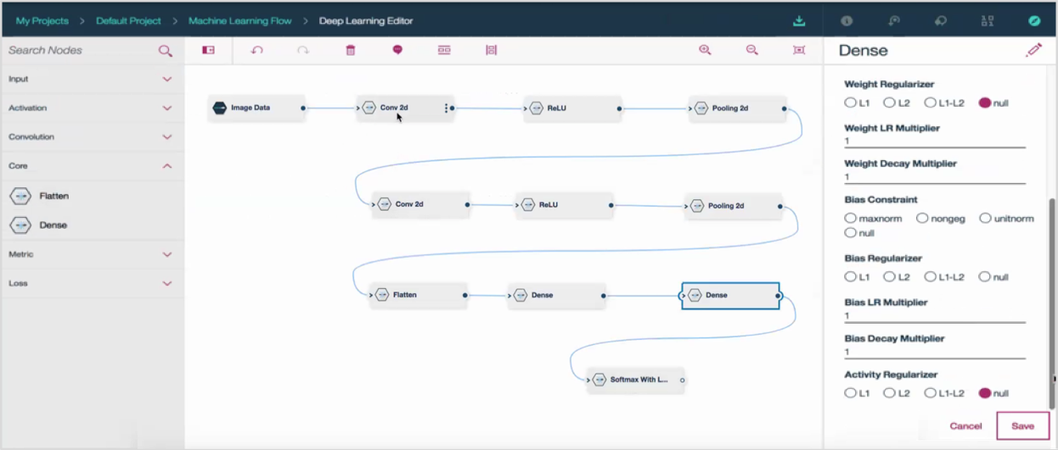
Neural Network Modeler (beta)
Supported Frameworks
An intuitive drag-and-drop, no-code interface for designing neural network structures using the most popular deep learning frameworks. Quickly capture your network design then single click export for experimental optimization.
Real-time validation of network flow
Define layer configuration
Choose optimizer params
Drag-and-drop
network layers
Generate CPU or GPU compatible code
Save as popular framework code
Export as a python notebook
Execute as batch experiment

Slide 12
Neural Network
Design
Experiment
Management
Technical
Deep Dive
Model
Hosting

Slide 13
Discovering a single optimal neural network requires exploring 1000’s of hyperparameter combinations
which means 100’s of experiments
which requires 1000’s of training runs

Slide 14
EXPERIMENTS
10’s-100’s
TRAINING RUNS
100’s-10000’s
Accelerate your
experimental workflow
>>
You focus on experiment design
NVIDIA GPU Acceleration
source code
experiment
definition
dataset
K80
P100
CPU-only
V100
We’ll manage the rest

Slide 15
Experiment Assistant accelerates discovering the optimal neural networks 100’s of experiments 10,000’s of training runs It’s here to serve you
design
neural network
experiments
evolve
train
evaluate

Slide 16
10’s-100’s experiments
batch_size
dropout
learning_rate
…
hyperparameters
designs
neural
network
varies
trains
100’s-1000’s
models
evaluates
Experiment Assistant
supports the end-to-end workflow
Notes:
Traditional machine learning focuses on selecting the right algorithm then tweaking the few available parameters. Deep learning significantly increases the complexity of model building by requiring data scientists to first design then tweak the dozens of interrelated parameters in neural networks structures. But AI is where all the complexity converges. We speak about AI as though it’s a single model or neural network but it’s not. AI is about multiple algorithms, neural networks, data and support systems working together as a system. So the challenge of AI is not about training a single model but about architecting numerous data-driven services which that the underlying complexity and hidden and emerges as a seemingly cognitive system.

Slide 17
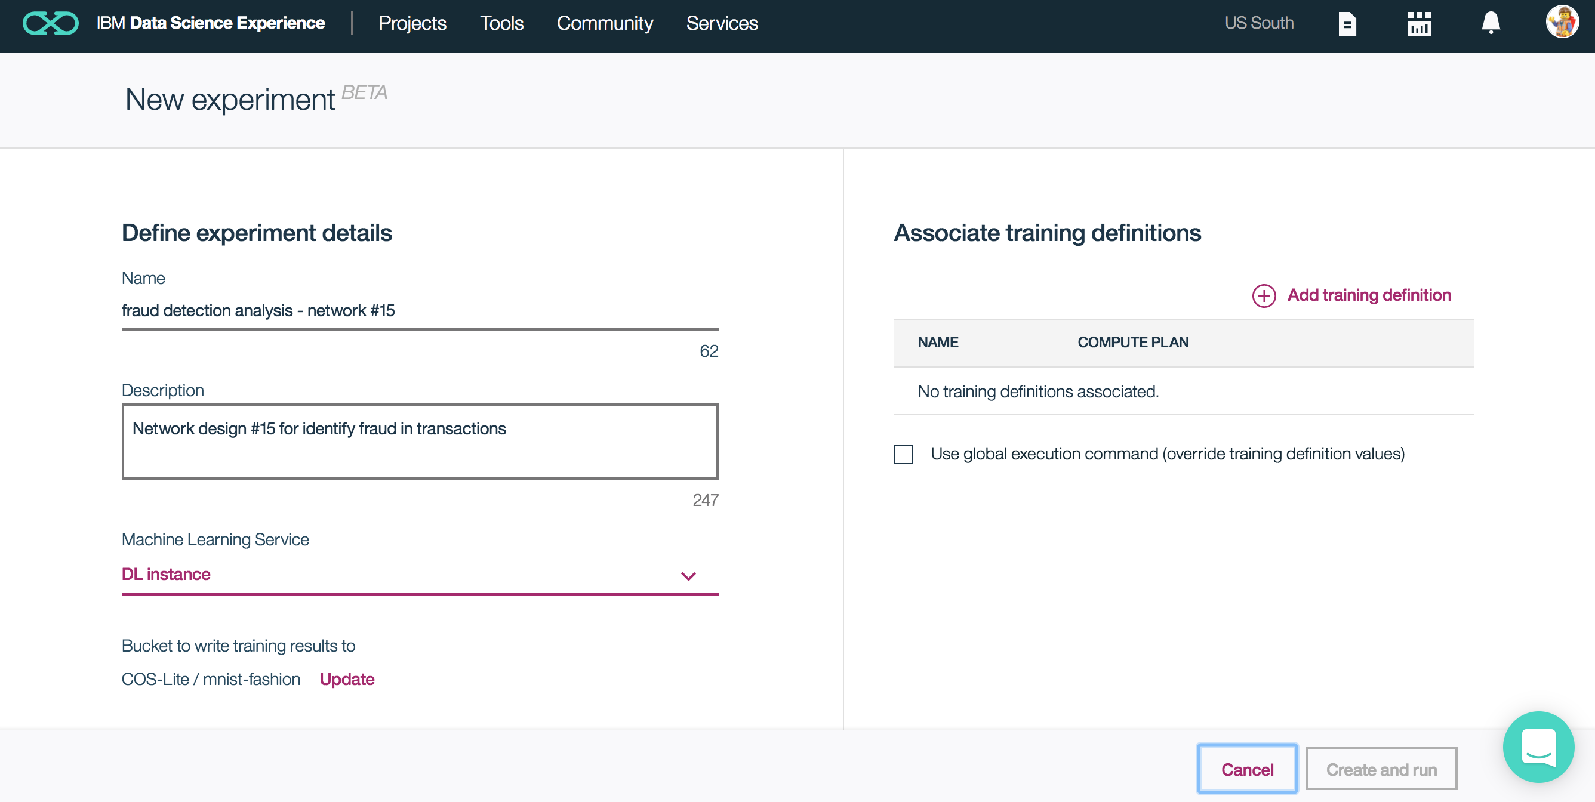
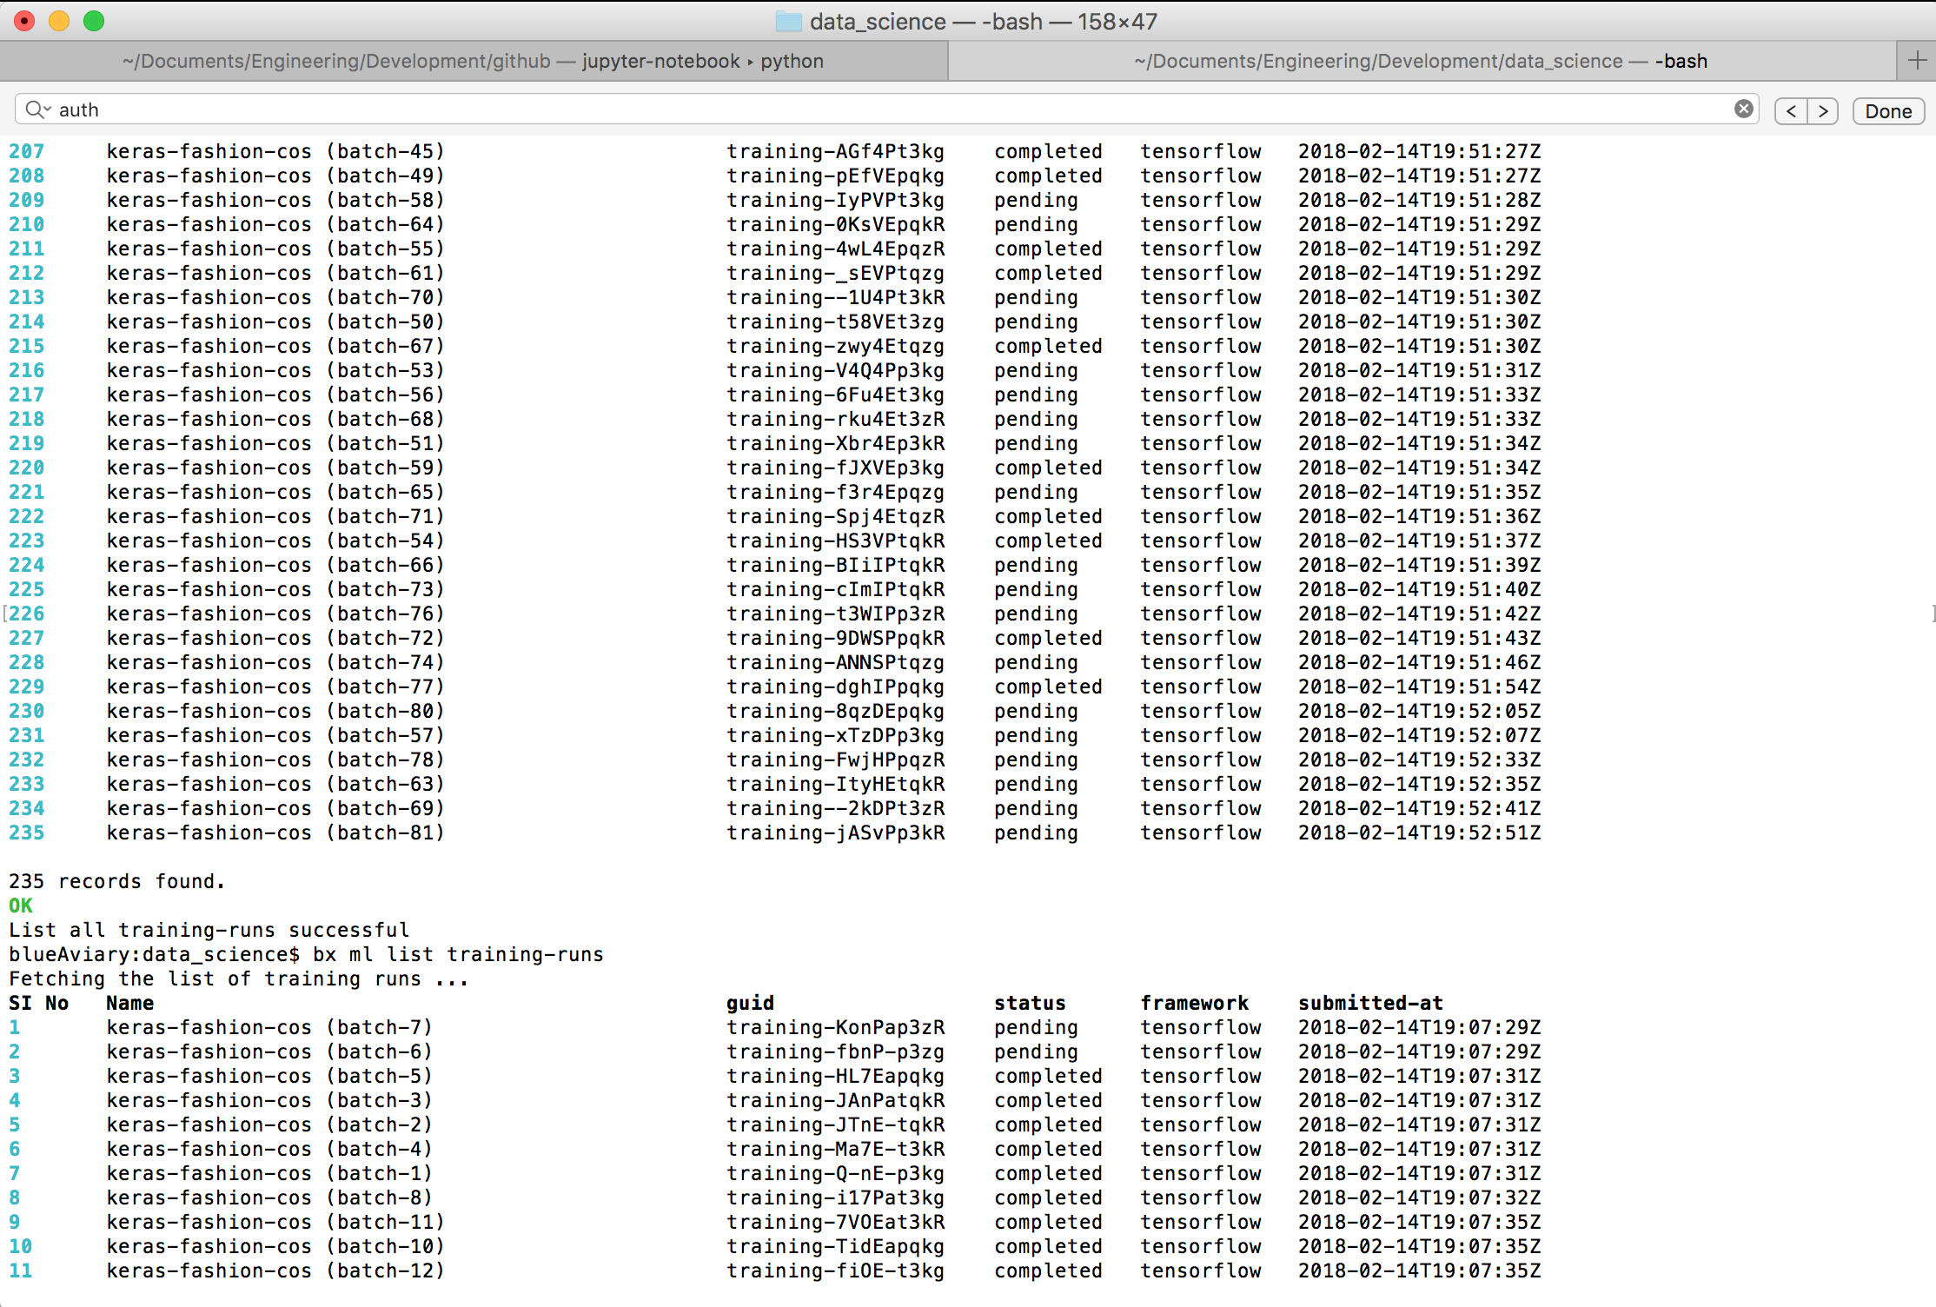
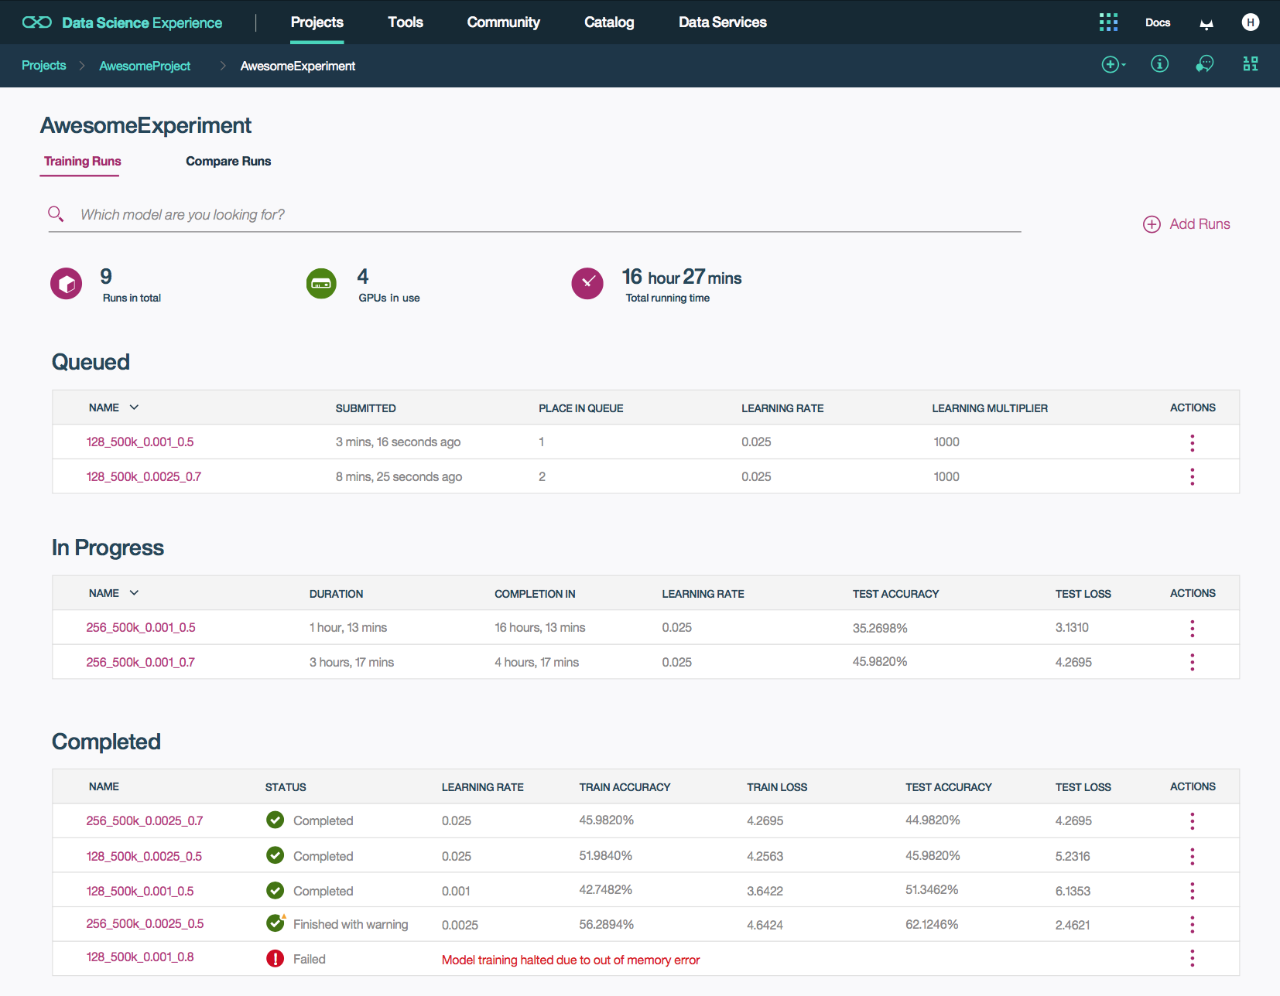
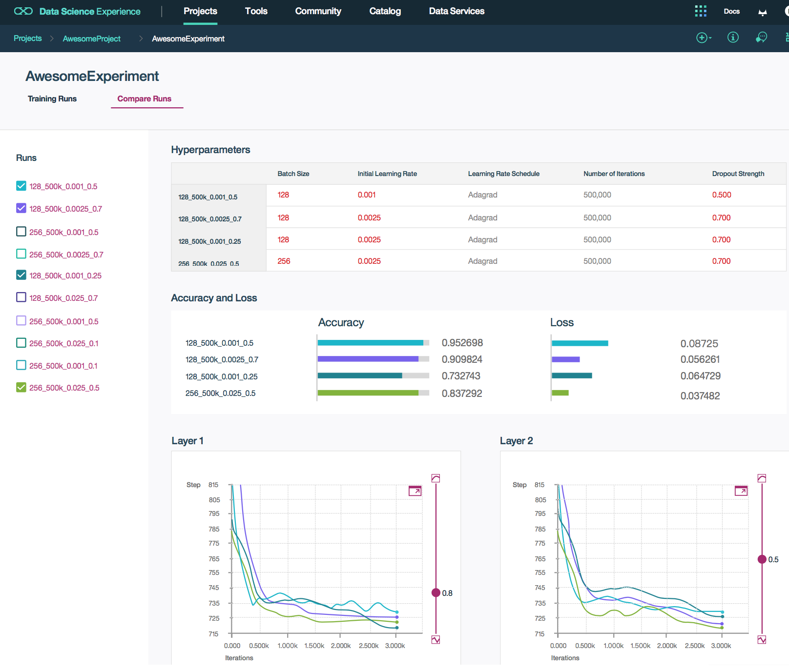
Experiment Assistant
A suite of tools that manage your training runs. Each run is automatically started, monitored, and stopped upon completion. Training history and assets are tracked then automatically transferred to the customer’s Object Storage for quick access.
Initiate Experiments
CLI or Python Client
Monitor Training in Real-Time
Compare Model Performance

Slide 18
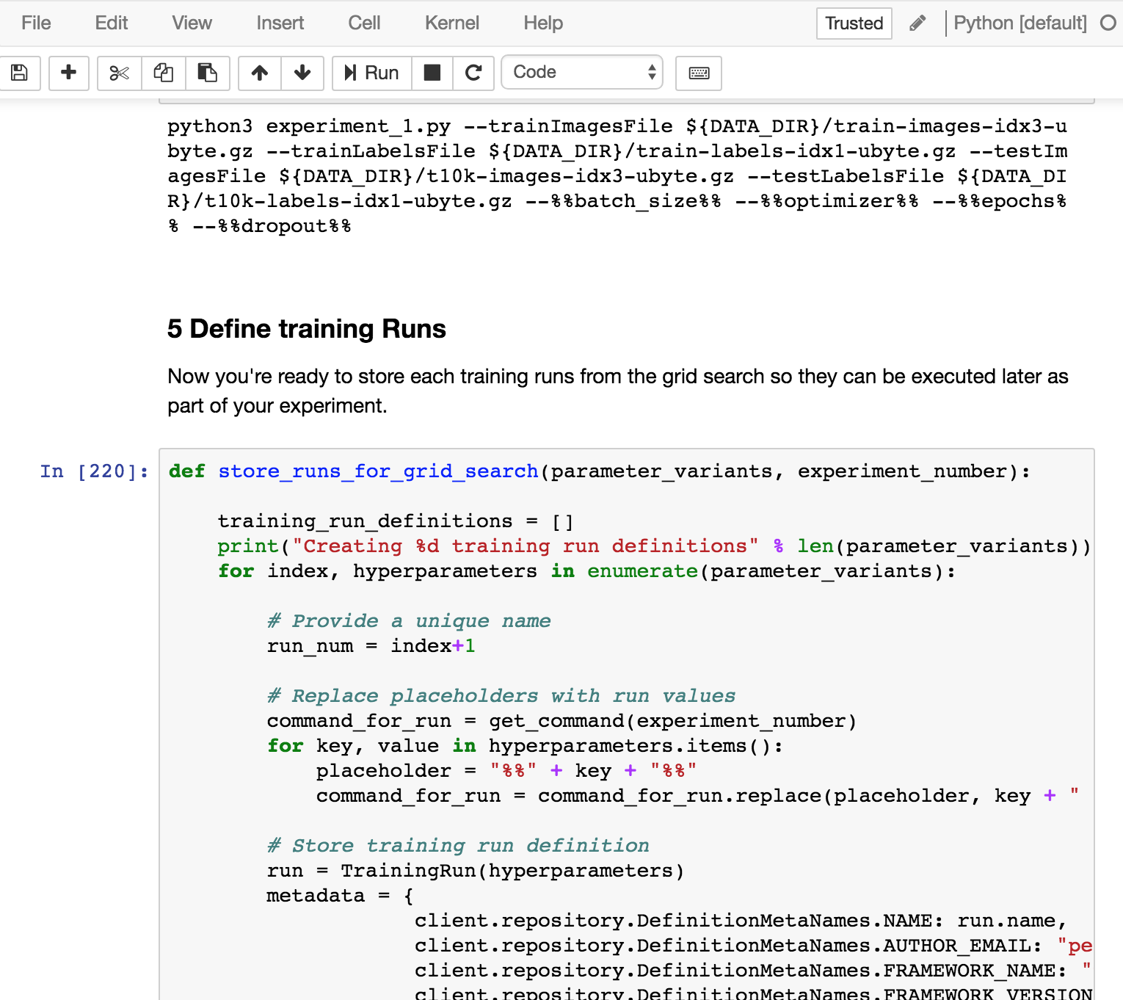
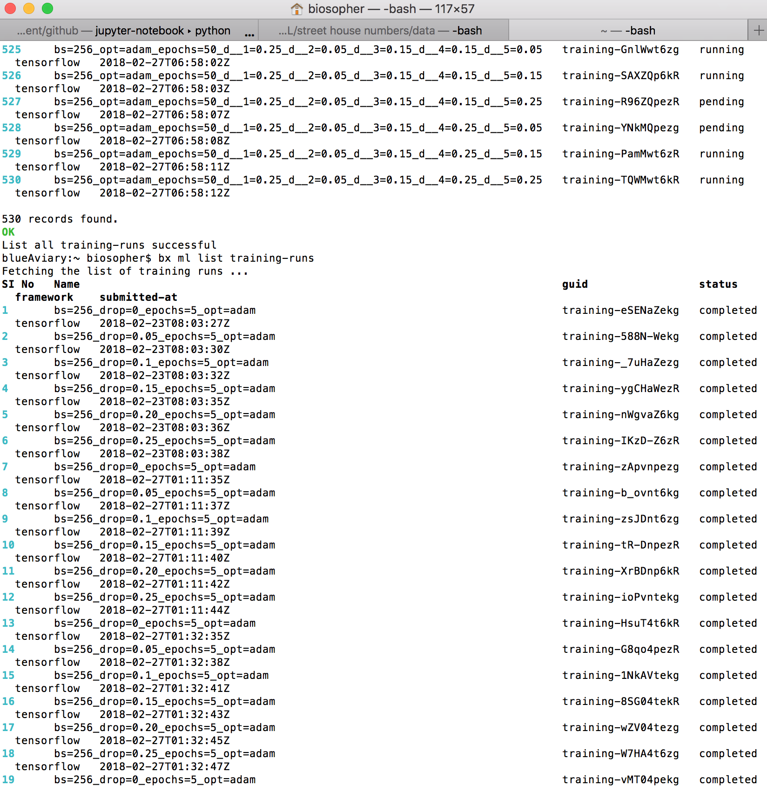
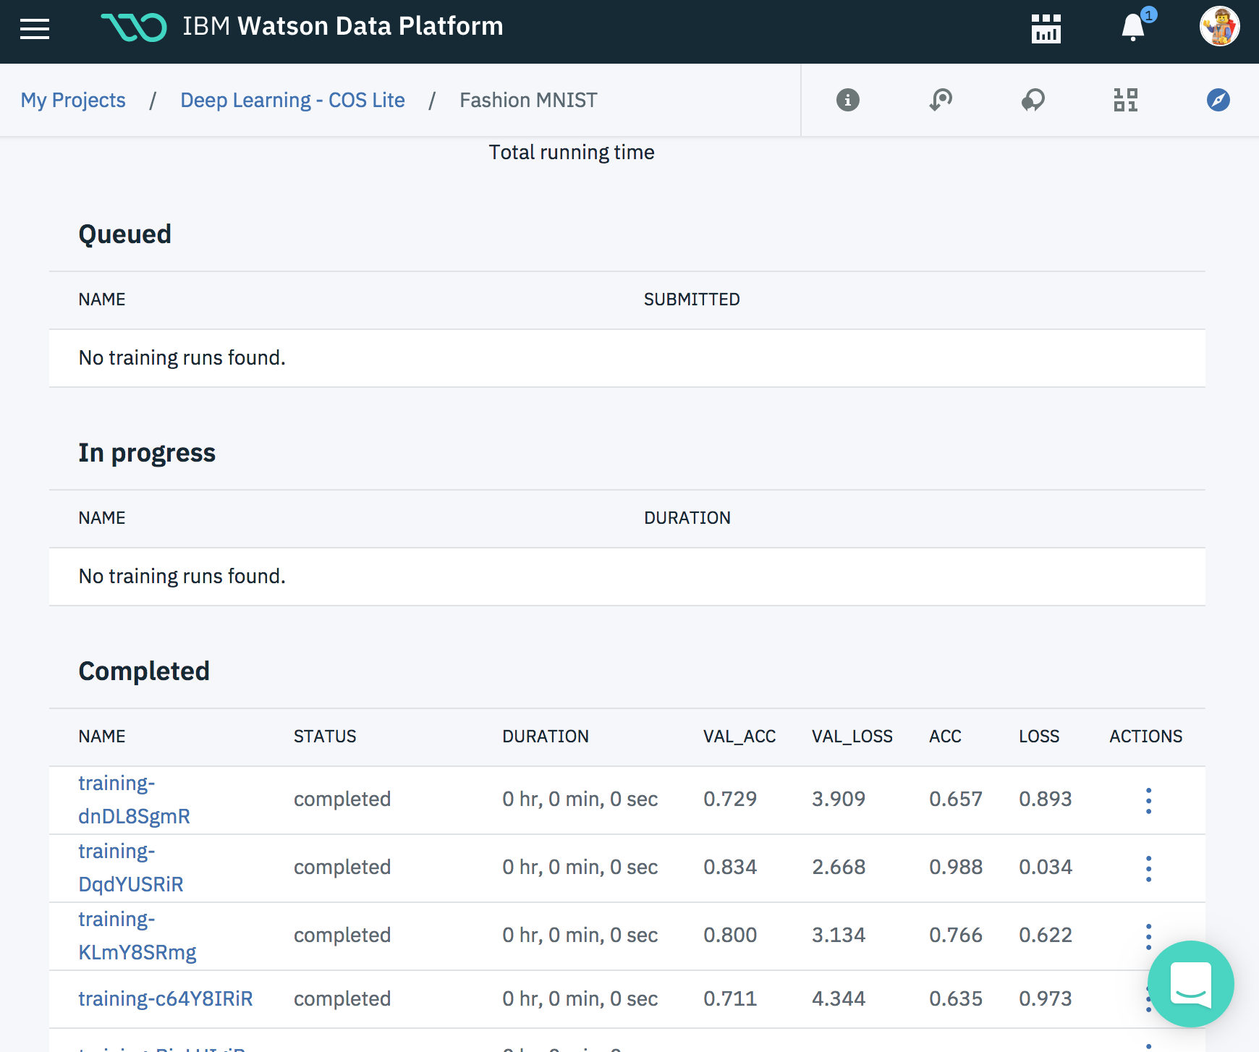
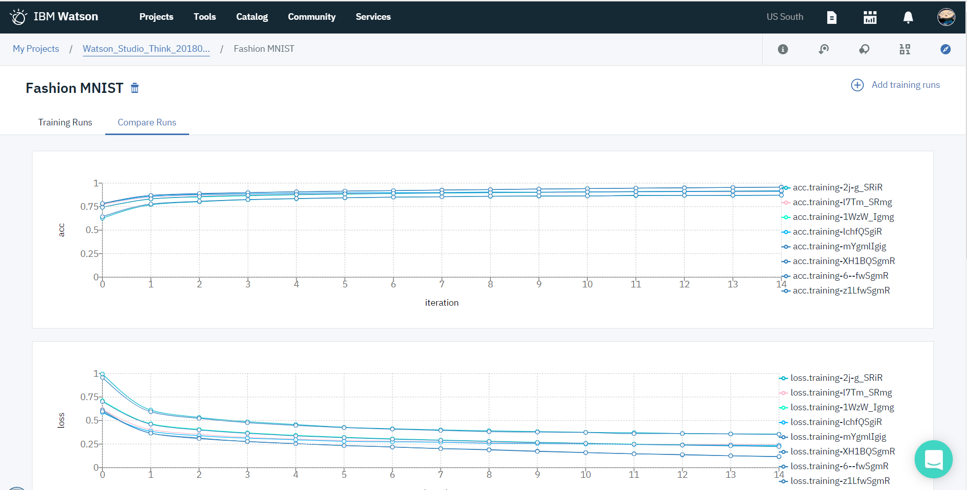
Accessing
Experiment Assistant
Python Client
Command Line
GUI
Notes:
Traditional machine learning focuses on selecting the right algorithm then tweaking the few available parameters. Deep learning significantly increases the complexity of model building by requiring data scientists to first design then tweak the dozens of interrelated parameters in neural networks structures. But AI is where all the complexity converges. We speak about AI as though it’s a single model or neural network but it’s not. AI is about multiple algorithms, neural networks, data and support systems working together as a system. So the challenge of AI is not about training a single model but about architecting numerous data-driven services which that the underlying complexity and hidden and emerges as a seemingly cognitive system.

Slide 19




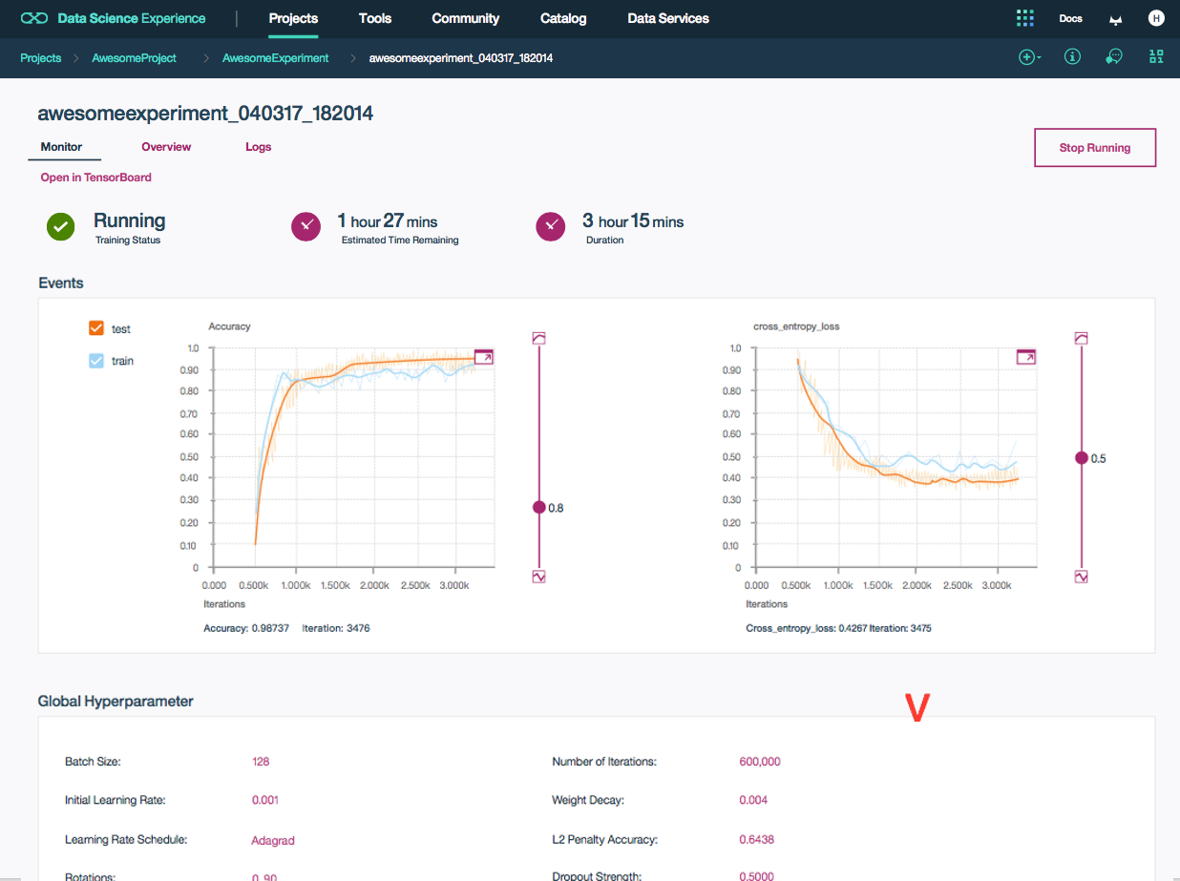
Save time: not just money. Use your preferred IDE and existing workflows. CLI, python library, and REST access is balanced by visual debugging tools. Design and optimize your networks better and faster.
Validated and Evolving Cloud Infrastructure: optimized for enterprise production environments and running on the same infrastructure hosting IBM Watson’s own cognitive services.
Hyperparameter Optimization: Efficiently automate searching your network’s hyperparameter space to ensure the best model performance with the fewest training runs.
Collaborate with team members: Share your deep learning experiments, debug your neural network structures, access common data within hosted object stores, forward versioned models to your development team then let them submit new data into your continuous learning flow.
Code with your favorite frameworks and tools
Graphs not Log Files: Don’t stare at text logs when you can overlay accuracy and loss graphs to dive deeper into the training of your neural networks. Track then view model hyperparameters so you can start understanding the progress of training individual layers in your network.
Use your personal IDE or a Jupyter notebook hosted in DSX while using the most popular deep learning frameworks
Don’t be constrained. Select the framework appropriate to the unique requirements of your problem domain and skills of your team. Or try a simpler approach and use a high-level meta-framework like Keras to accelerate model exploration by abstracting away low level complexity.

Slide 20
Neural Network
Design
Experiment
Management
Technical
Deep Dive
Model
Hosting

Slide 21
Training Lifecycle Management
Auto-allocation means paying only for what you use
training run
definition
training
artifacts
source code
Training assets are
managed and tracked.
Kubernetes container
Cloud Object Storage
compute cluster
NVIDIA Tesla K80, P100, V100

Slide 22
Train 1000’s of neural networks
Use Hyperparameter optimization (HPO) or define your own training runs
hyperparmeters
static
epochs: 25
optimizer
batch_size: 32,64,128,256
optimizer: adam, sgd
model
dropout_1 = 0 – 1.0
dropout_2 = 0 – 1.0
dropout_3 = 0 – 1.0
dropout_4 = 0 – 1.0
neural network variants
base
neural network

Slide 23

Training distributed across parallel containers
Use Hyperparameter optimization (HPO) or define your own training runs
training runs
containers
Kubernetes
container orchestration
server cluster
NVIDIA GPUs
dataset
Cloud Object Storage

Slide 24
Experiment assistance manages and archives training progress
Monitor training progress and compare model performance in real-time
trained models + artifacts
Cloud Object Storage
Experiment Assistant
Monitor Training in Real-Time
Compare Model Performance

Slide 25
Distributed Learning w/Tensorflow
Native TensorFlow
IBM Distributed Deep Learning (DDL)
Uber’s Horovod
As datasets expand and model grow in complexity, training times increase from hour to days to weeks or longer to complete.
Models no longer fit on one or multiple GPUs within a single server and must be distributed across multiple machines.

Slide 26
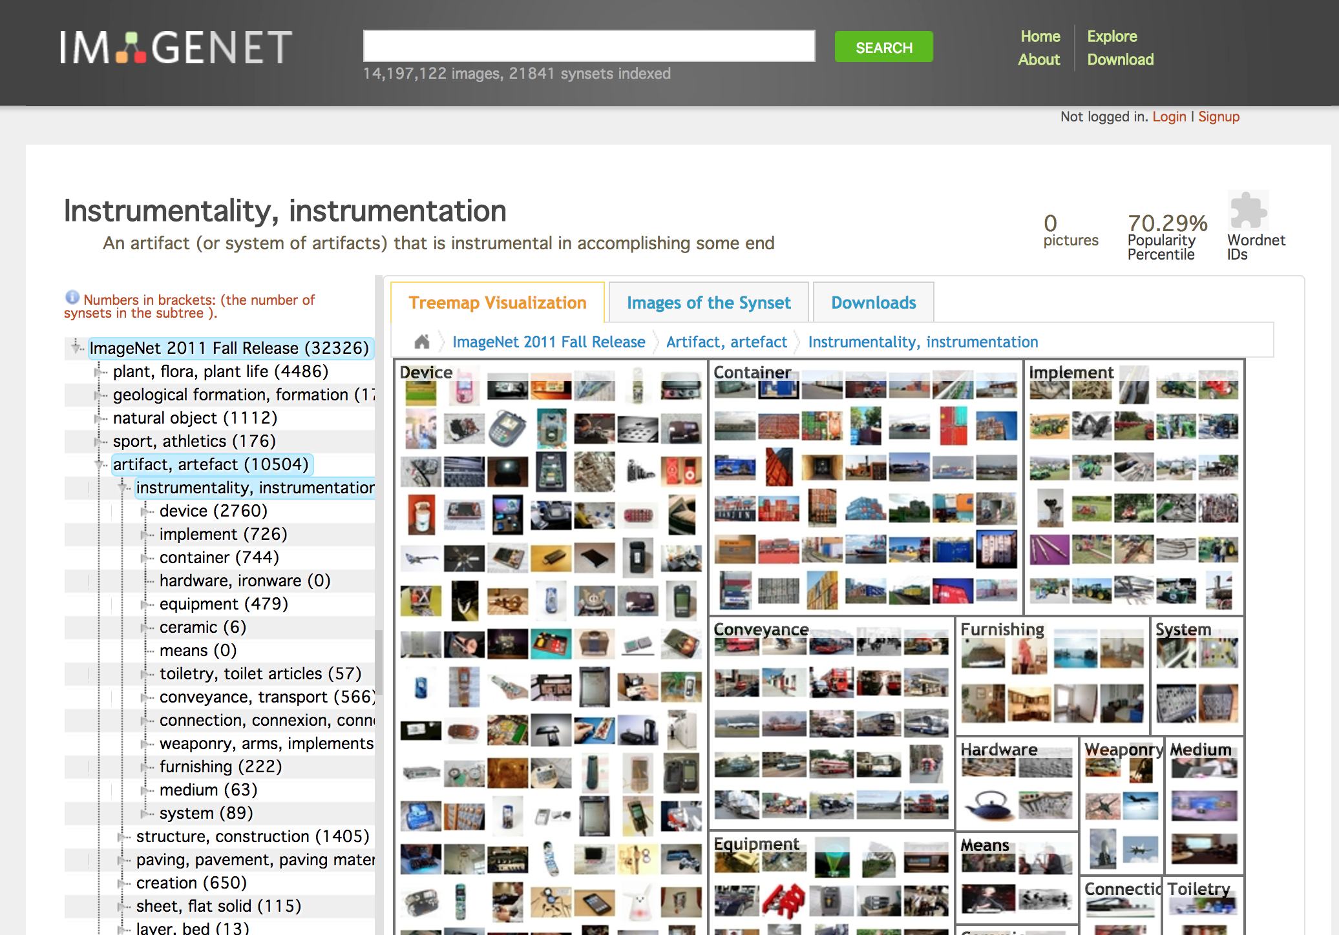
What about massive datasets like ImageNet 22K?
14 million images
3 Terabytes
21,841 categories

Slide 27
Single servers are too slow for complicated networks and large datasets
Resnet101
ImageNet 22K
14 million images
3 TB
server
16 days
training time
4 NVIDIA P100 GPUs

Slide 28
Distributed training across multiple servers
sync parameters
model
model copy
server
server
data

Slide 29
Distributed training at scale
sync parameters
resnet
101
ImageNet 22K
14 million images
3 TB
…
~7 hours
training time
1
2
64
2xV100s
2xV100s
2xV100s
…
1
2
64

Slide 30
Neural Network
Design
Experiment
Management
Technical
Deep Dive
Model
Hosting

Slide 31
Deep Learning
Available through Watson Machine Learning
Notes:
Traditional machine learning focuses on selecting the right algorithm then tweaking the few available parameters. Deep learning significantly increases the complexity of model building by requiring data scientists to first design then tweak the dozens of interrelated parameters in neural networks structures. But AI is where all the complexity converges. We speak about AI as though it’s a single model or neural network but it’s not. AI is about multiple algorithms, neural networks, data and support systems working together as a system. So the challenge of AI is not about training a single model but about architecting numerous data-driven services which that the underlying complexity and hidden and emerges as a seemingly cognitive system.

Slide 32

Hosted ML Infrastructure
Watson Machine Learning (WML) is a managed learning service optimized for production environments that enables train plus deploy of new models.
Your Data Team
Watson Machine Learning
Training infrastructure
deploy
infrastructure
artifact
repository

Slide 33
Deploying Trained Models
Download your trained models or deploy your models within Watson Machine Learning
Watson Machine Learning
train
infrastructure
deploy
REST
API
prediction
App
REST
API
prediction
App
artifact
repository
hosted
models
REST
API
prediction
App
REST
API
prediction
App

Slide 34
Asset Lifecycle Management
Use the Watson Knowledge Catalog and Watson Studio to manage your machine learning asset or manage them yourself
Watson Machine Learning
Model Explanations
In May 2018, the General Data Protection Regulation (GDPR) takes effect and grants consumers the legal “right to explanation” from organizations that use algorithmic decision making.
Training infrastructure
deploy
infrastructure
artifact
repository
Watson Knowledge
Catalog
Audit Trails
Tracking prediction to each model’s unique heritage is critical to regulatory complicance. Enforcing access controls for model sharing and deployment ensure ensures data security and application stability.
datasets
source code
pipelines
models
experiment
definitions

Slide 35
Watson Machine Learning
Simplifying deployment & management of ML models in production apps
Embed AI in your Business
Train
Deploy
Automate
Train custom ML and DL models at scale
Move models into production where they improve and remain relevant
Build better models faster while they continue to learn after
Use your favorite tools and frameworks such as SPSS, Tensorflow, Keras, Scikit Learn or xgboost.
Track the progress and performance of your training jobs with the Experiment Assistant interface.
Create new models without writing a single line of code using the neural network modeler
Portable models – deploy in the cloud, on devices or on premise
Import models trained somewhere else and deploy in the cloud
Transfer models to connected devices with support of Core ML, Tensorflow Lite
Make millions of predictions in seconds
Build better models faster with automatic parameter tuning
Automate the retraining of models with our feedback loop capabilities
Automate the deployment of models in products
Automatic algorithm selection for ML models with our CADS technology from Research
3
Notes:
IBM Data Refinery is a fully managed self-service data preparation experience enabling non-technical and technical users to easily put data to work and make it fit for use by simplifying data preparation to accelerate data insights.
Users can ACT on their data. It provides the ability to get instant access to your data regardless of where it resides, either on the cloud or on-premises. Users can combine data together from multiple relevant data sources to create powerful insights and then transform the data by refining, shaping and cleansing it, using a robust set of transformation operations, and then deliver it with confidence to their desired target for analytical insight.
The service is fully managed by IBM so you can sleep better at night. Pay-as-you-go and subscription pricing options are available so you can get started quickly.
Data Refinery is powered by Spark for a speedy and responsive experience. It leverages Spark as it’s processing engine for performance and efficiency. In fact, the move to Spark reduced the lines of code from 40 million down to 4 million.
Data Refinery is available exclusively through Bluemix and can easily integrate data across different platforms, cloud and on-premises, and is seamlessly embedded and integrated within Watson Analytics.
Data Refinery empowers non-technical and technical users self-service access to their data from anywhere, anytime, making data simple for everyone to put data to work. Business and citizen analysts, developers and data engineers benefit from the value of Data Refinery. However, the primary personas targeted by Data Refinery are business owners and their staff; business and citizen analysts, data scientists and data engineers. Developers can take advantage of and utilize the Data Refinery Restful API, but they would not be considered a primary user of the service.
Business and citizen analysts can easily find and use the data they need to accelerate data based business decisions using timely, accurate and trusted information.
Data engineers can enable self-service data access to end users using elastic deployment through the cloud and deliver the data faster while maintaining important controls such as data governance and security. This allows them to break free from routine data requests and focus on additional value for an organization such as implementing and enforcing corporate standards, security, data governance and complex requirements.
And now, currently in beta, using the Data Design Flow feature of Data Refinery, data engineers can quickly build data pipelines and workflows to transform and move data without the need for deep ETL development skills.
Developers can quickly develop data-rich applications by embedding the Data Refinery service REST API (Application Programming Interface) into new or existing applications.
Data Refinery saves time and resources by reducing the effort to provision trusted data and make it fit for use.

Slide 36
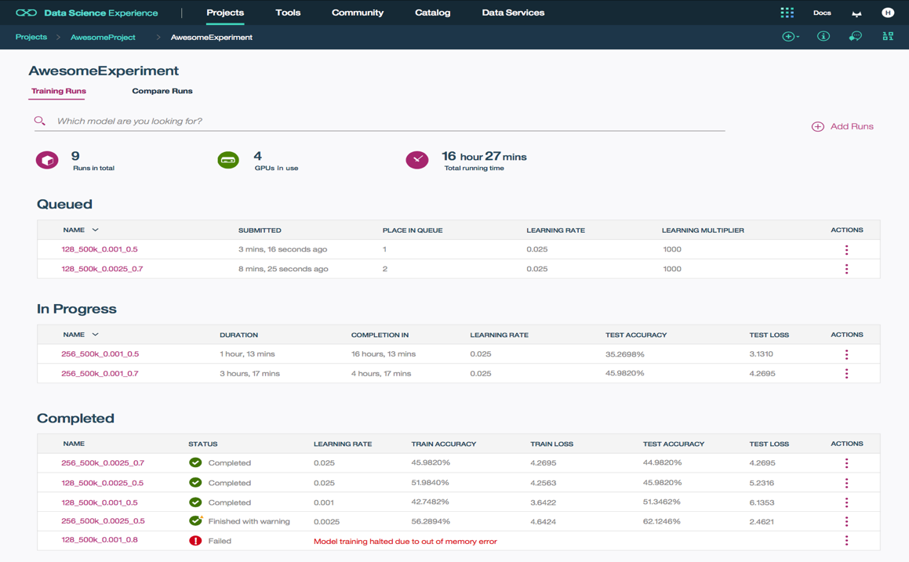
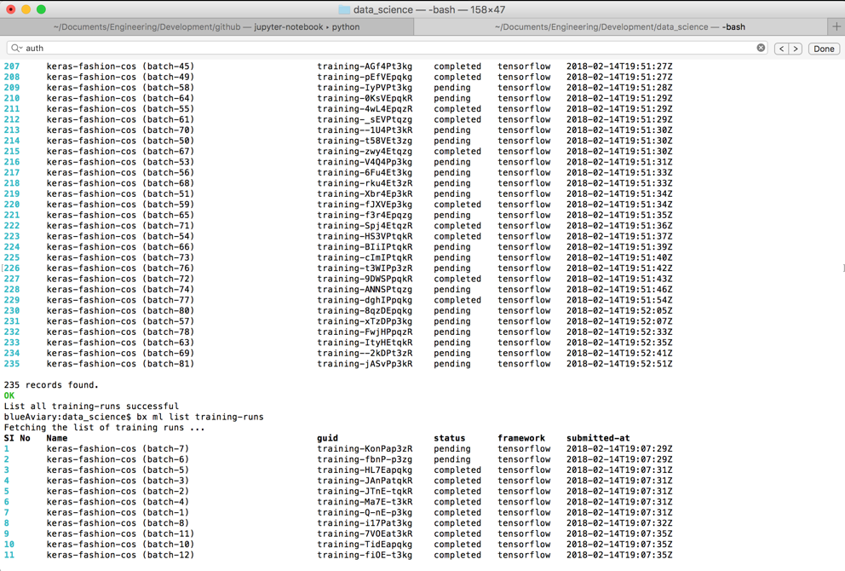

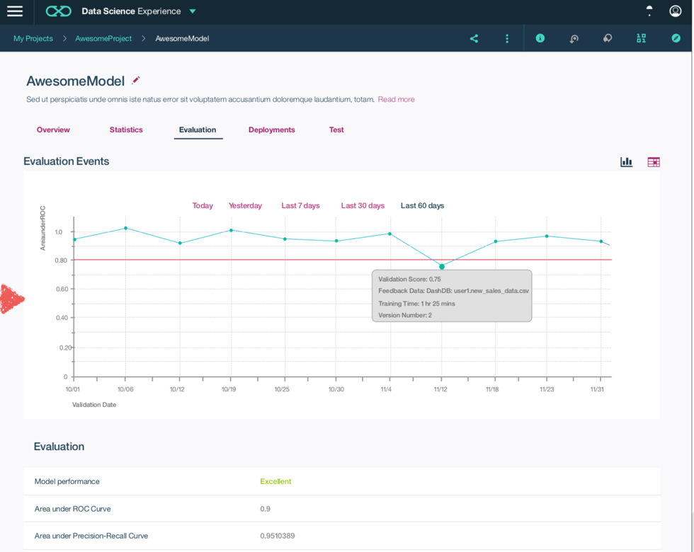
Watson Machine Learning
Simplifying deployment & management of ML models in production apps
Python client, command line interface (CLI) or UI? You choose the tooling that best fits your existing workflows. Training history and assets are tracked then automatically transferred to the customer’s Object Storage for quick access.
Train neural networks in parallel across NVIDIA GPUs.
Pay only for what you use. Auto-deallocation means no more remembering to shutdown your cloud training instances.
Monitor batch training experiments then compare cross-model performance without worrying about log transfers and scripts to visualize results. You focus on designing your neural networks. We’ll manage and track your assets.
Deploy models into production then monitor them to evaluate performance.
Capture new data for continuous learning and retrain models so they continually adapt to changing conditions.
3
Notes:
IBM Data Refinery is a fully managed self-service data preparation experience enabling non-technical and technical users to easily put data to work and make it fit for use by simplifying data preparation to accelerate data insights.
Users can ACT on their data. It provides the ability to get instant access to your data regardless of where it resides, either on the cloud or on-premises. Users can combine data together from multiple relevant data sources to create powerful insights and then transform the data by refining, shaping and cleansing it, using a robust set of transformation operations, and then deliver it with confidence to their desired target for analytical insight.
The service is fully managed by IBM so you can sleep better at night. Pay-as-you-go and subscription pricing options are available so you can get started quickly.
Data Refinery is powered by Spark for a speedy and responsive experience. It leverages Spark as it’s processing engine for performance and efficiency. In fact, the move to Spark reduced the lines of code from 40 million down to 4 million.
Data Refinery is available exclusively through Bluemix and can easily integrate data across different platforms, cloud and on-premises, and is seamlessly embedded and integrated within Watson Analytics.
Data Refinery empowers non-technical and technical users self-service access to their data from anywhere, anytime, making data simple for everyone to put data to work. Business and citizen analysts, developers and data engineers benefit from the value of Data Refinery. However, the primary personas targeted by Data Refinery are business owners and their staff; business and citizen analysts, data scientists and data engineers. Developers can take advantage of and utilize the Data Refinery Restful API, but they would not be considered a primary user of the service.
Business and citizen analysts can easily find and use the data they need to accelerate data based business decisions using timely, accurate and trusted information.
Data engineers can enable self-service data access to end users using elastic deployment through the cloud and deliver the data faster while maintaining important controls such as data governance and security. This allows them to break free from routine data requests and focus on additional value for an organization such as implementing and enforcing corporate standards, security, data governance and complex requirements.
And now, currently in beta, using the Data Design Flow feature of Data Refinery, data engineers can quickly build data pipelines and workflows to transform and move data without the need for deep ETL development skills.
Developers can quickly develop data-rich applications by embedding the Data Refinery service REST API (Application Programming Interface) into new or existing applications.
Data Refinery saves time and resources by reducing the effort to provision trusted data and make it fit for use.

Slide 37
IBM Watson Studio is for AI
Notes:
Traditional machine learning focuses on selecting the right algorithm then tweaking the few available parameters. Deep learning significantly increases the complexity of model building by requiring data scientists to first design then tweak the dozens of interrelated parameters in neural networks structures. But AI is where all the complexity converges. We speak about AI as though it’s a single model or neural network but it’s not. AI is about multiple algorithms, neural networks, data and support systems working together as a system. So the challenge of AI is not about training a single model but about architecting numerous data-driven services which that the underlying complexity and hidden and emerges as a seemingly cognitive system.

